Slide 1
ANIMAL CONSUMPTION, IS IT WORTH IT?
Team GitVengers:
Binh, Cora , Ro, Ken

Slide 2
AGENDA
Project Objective
Our Data Process
Animal Consumption
Meat Production
Import / Export of Meat
Food Supply Subsidization
Conclusion

Slide 3
Project Objectives
The goal of our project was to determine the animal consumption by country and illustrate the supply rate of human consumption to the deficit and demand of meat available in the world. The data that we aimed to gather was the meat available based on land and agriculture (this excludes fish or aquatic resources).
Questions that we wanted to determine:
Where is animal consumption most popular?
Which countries consume the most meat?
Which countries produce the most meat?
How much meat is imported and exported globally? How do specific country groups compare to the world total?
Which countries are subsidizing food supply the most?

Slide 4
The Data Process

Slide 5
Data Exploration & Clean-Up Process
Defined questions to address
Searched on Google, Kaggle, Medium, Data.world to identify viable sources of data to use
Food Agriculture Organization of the United Nation (FAO) was our primary data source. The steps to extract data from this website included:
Identifying the reports
Agreeing on filters
Use Chrome’s Developer Tool feature to extract exact URL query parameters for Get Request
Read the csv and convert to Pandas DataFrame
Notes:
2) Searched on: google, kaggle, Medium, data.world
3) … extract exact url query parameters for Get Request
4) Read the csv and convert it to Pandas DataFrame
5)

Slide 6
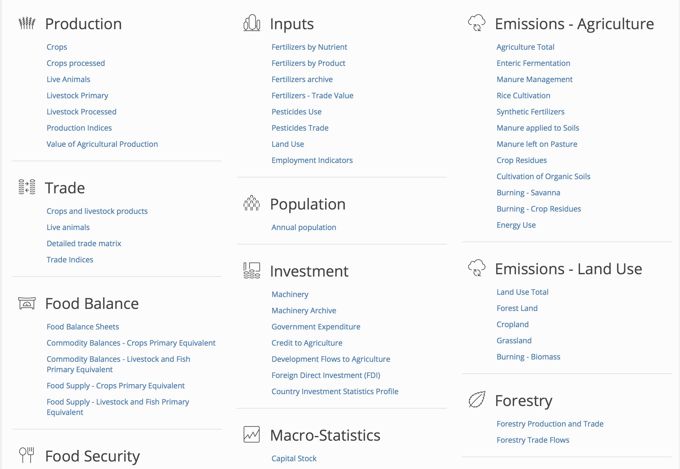
Food Agriculture Organization (FAO) Data Source

Slide 7
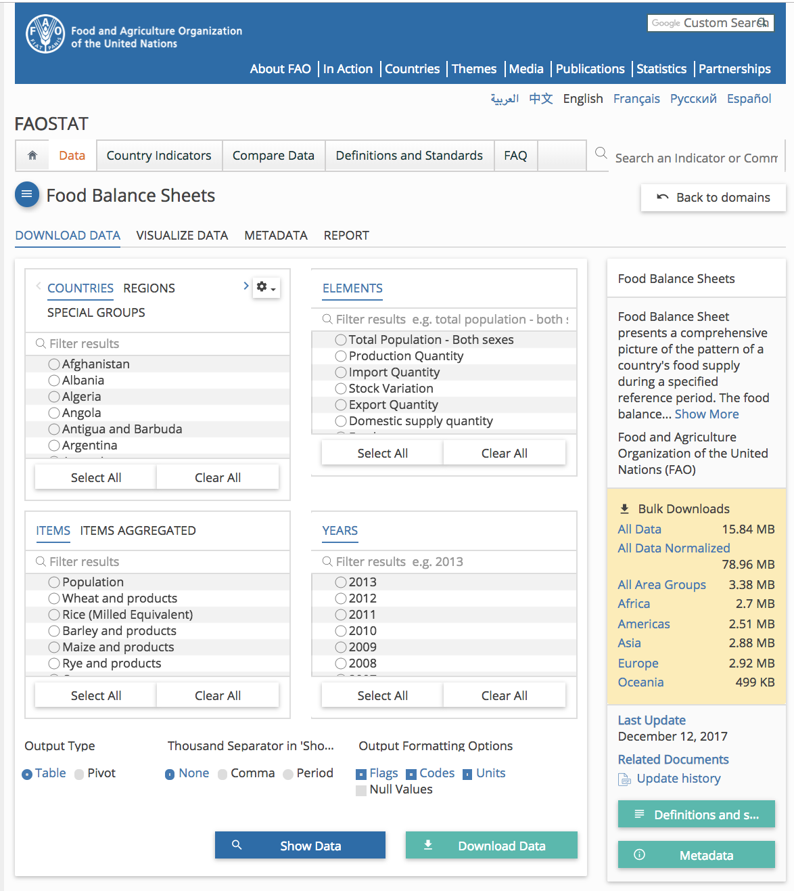
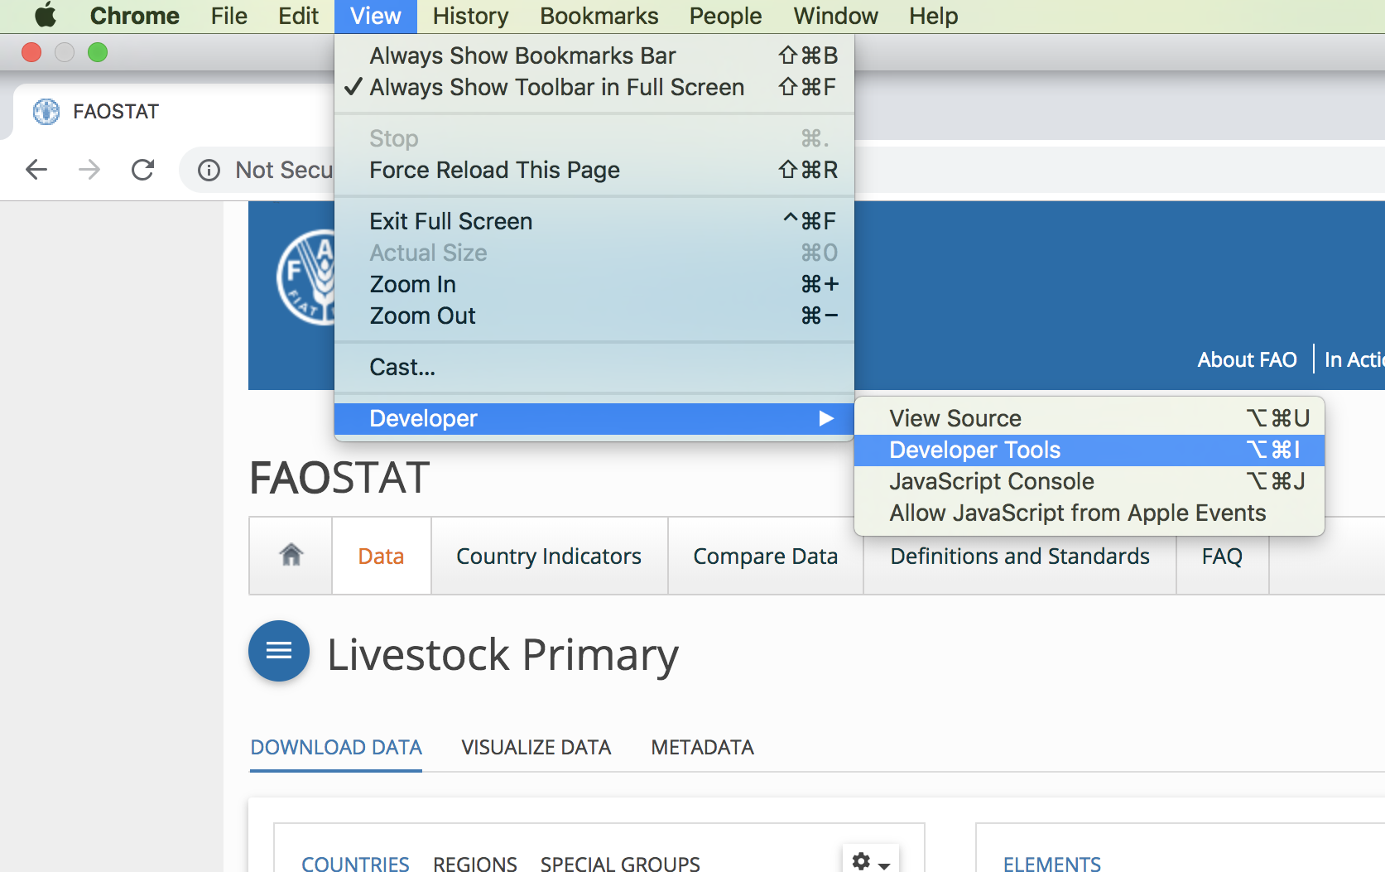
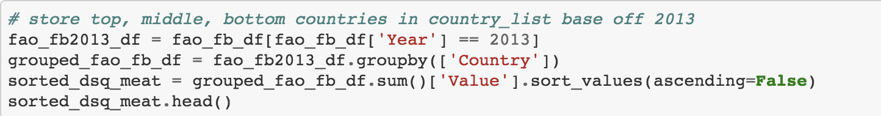
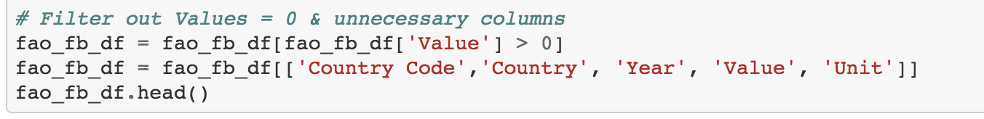
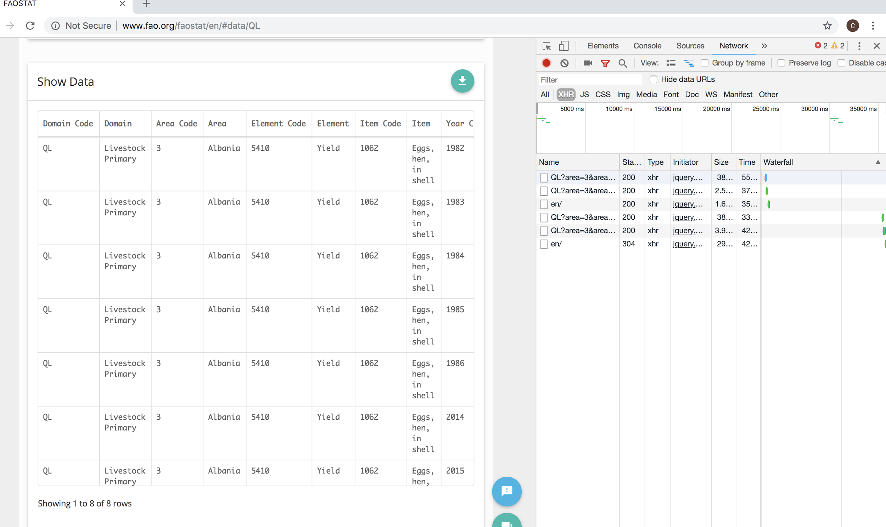
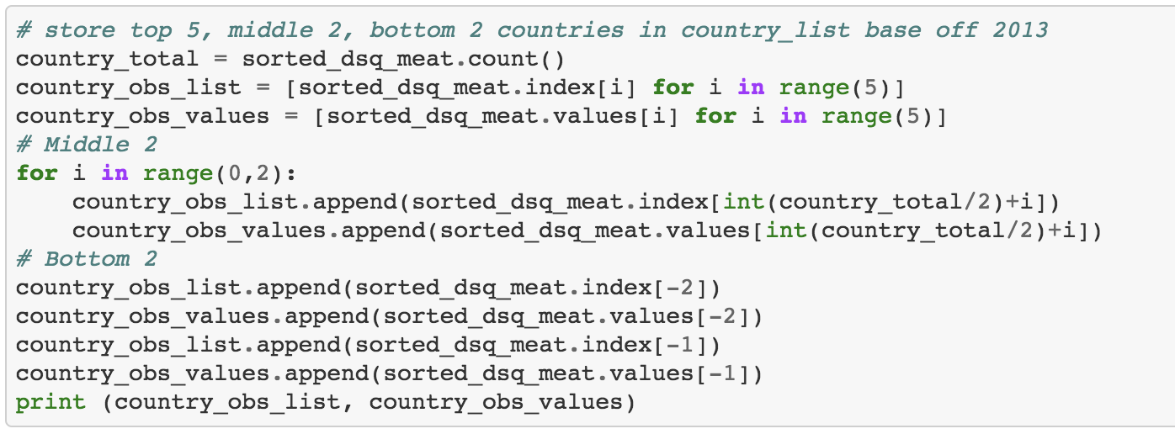
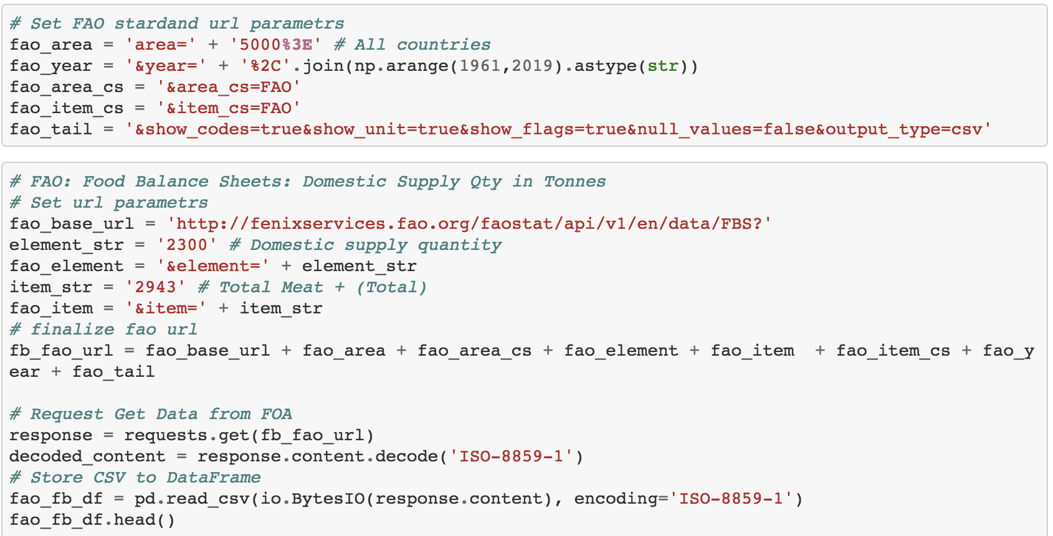
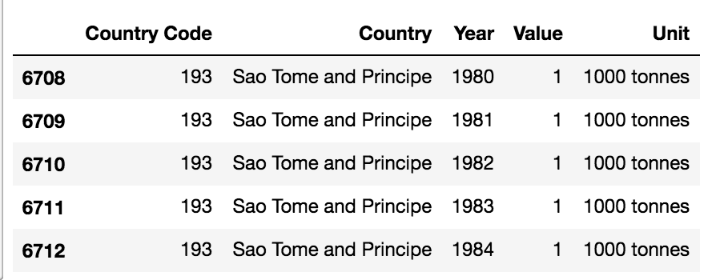
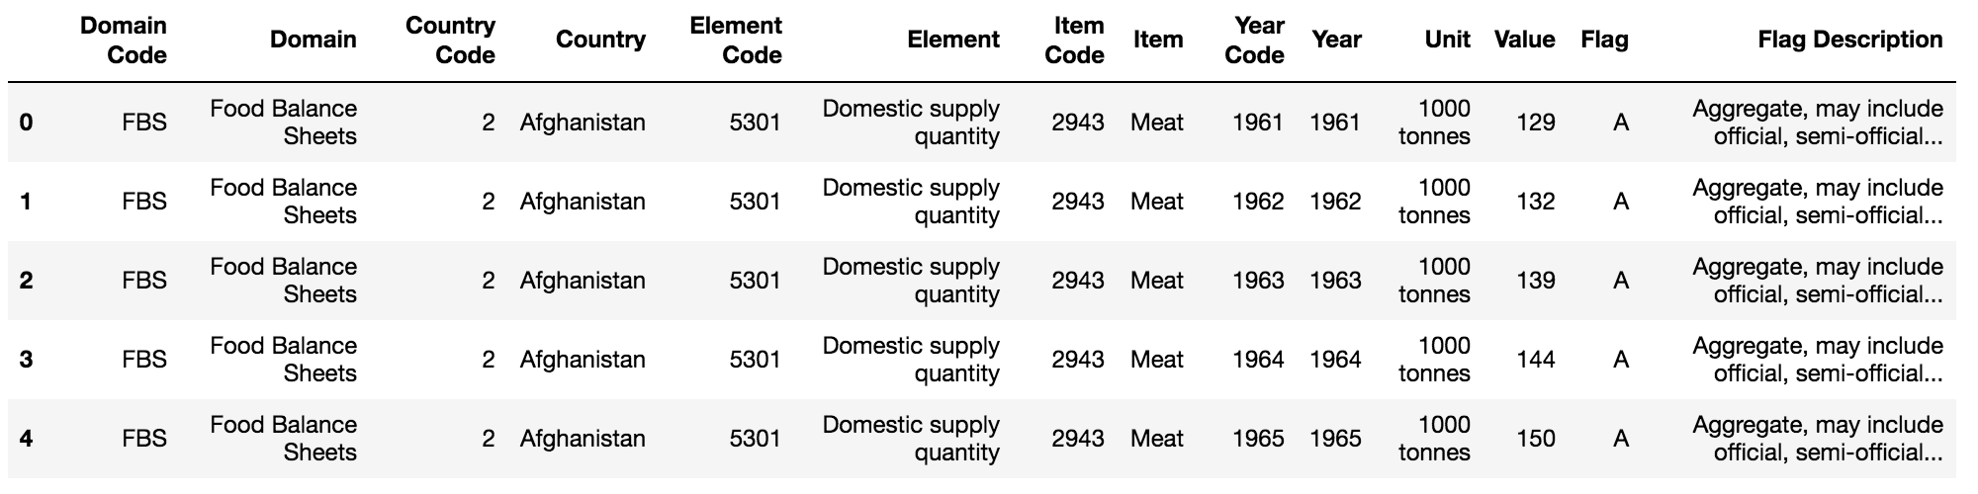
Data Exploration & Cleanup Process
Data Exploration Clean up Process (Filters)
Notes:
FAO’s Graphic User Interface for querying the specified Data
We used Chrome’s Developer Tools’ Network:XHR to figure out the URL’s parameters.
Get Request to read the cvs file data and convert to DataFrame
Sample of the Data
Fine comb the filter with Pandas DataFrame. Either by Year, removing 0 values or missing values. Sorting and taking the top, middle, bottom data.
Sample of the Data

Slide 8
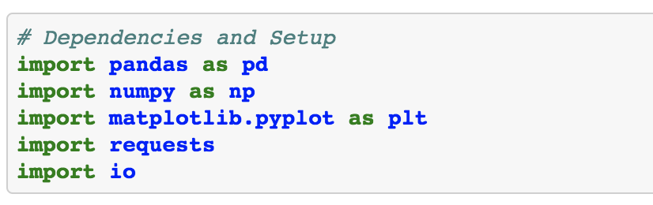
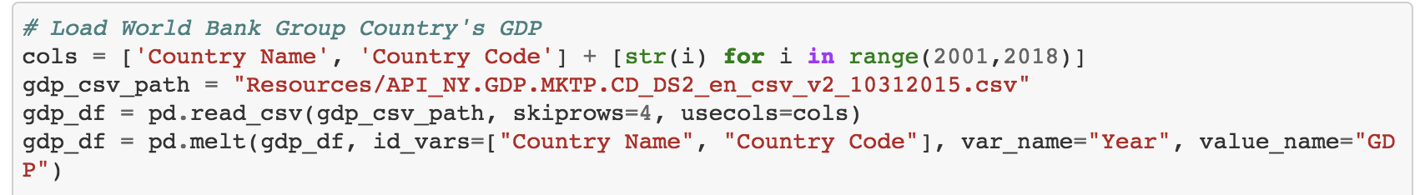
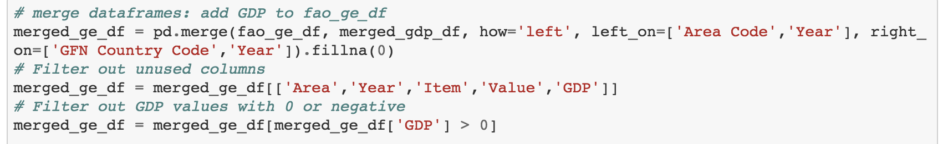
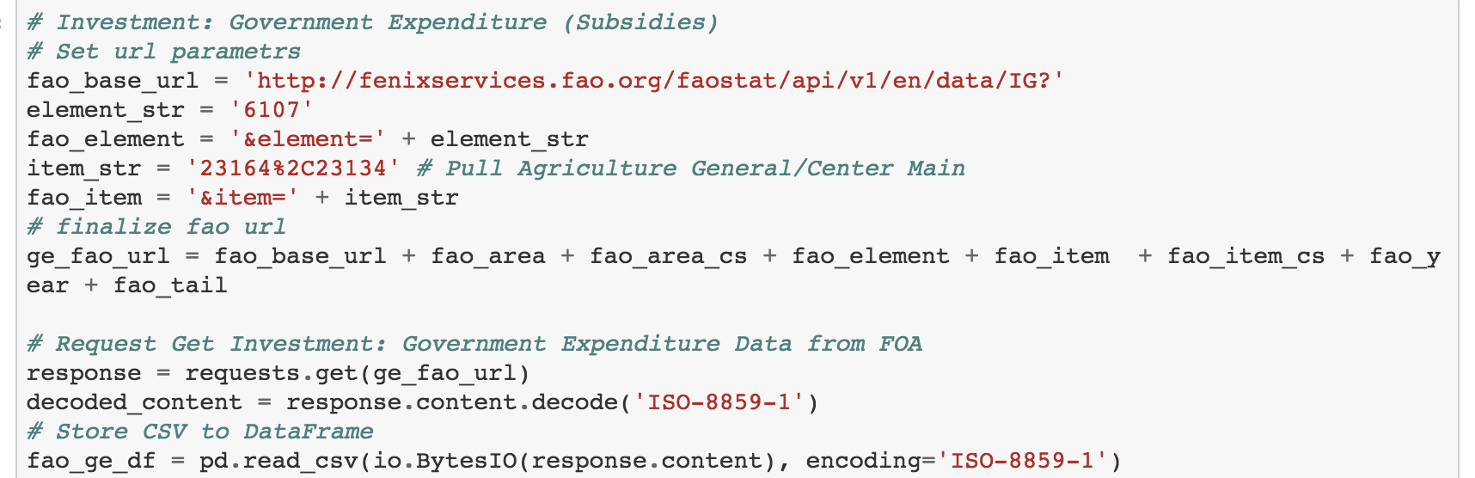
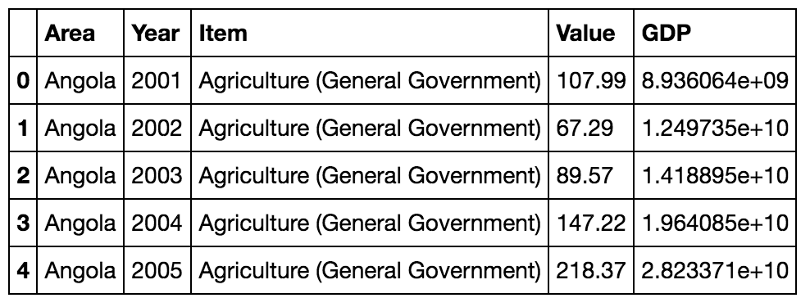
The Analysis Process
Modules
Plot Data
Load Data into DataFrames
Merge DataFrames & Filter
Finalize DataFrame
Plot Data
Notes:
Images:
1) The main modules we used
2) World bank Group data file for GDP, GFN Country Code for Standard Code, FAO url requests for Meat Data : into DataFrames
3) Merge DataFrames into one
5) Plot Map using matplotlib

Slide 9
Animal Consumption

Slide 10
Which Countries had the highest animal consumption rate?
One of the first questions that came to mind was: what part of the world consumed the most meat? We wanted to know which country ate the most meat because it could correlate to the most populated countries and possibly with the highest supply of resources.

Slide 11
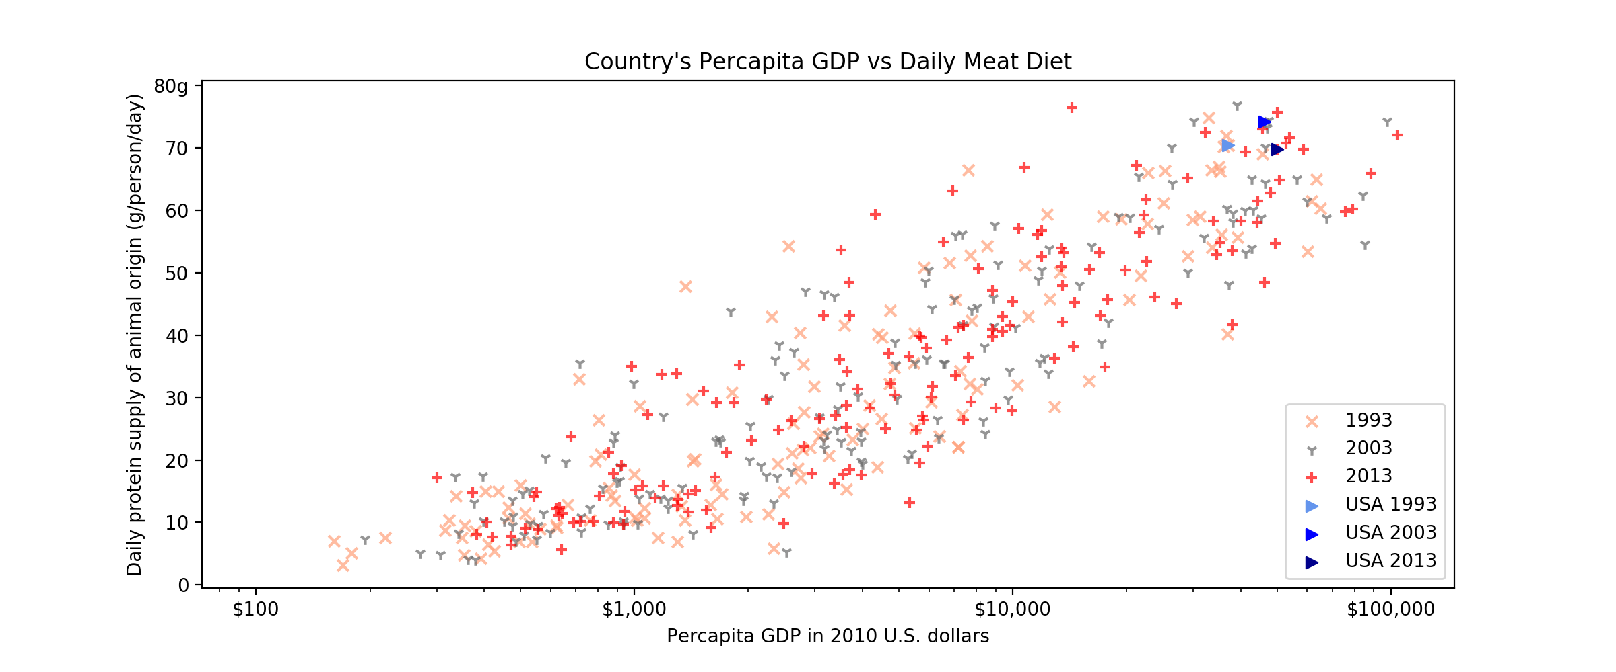
Where Is Animal Consumption Most Popular?
Notes:
Higher GDP tends to have higher meat diet. Average American consumes 222.2 lbs of meat a year in 2018

Slide 12
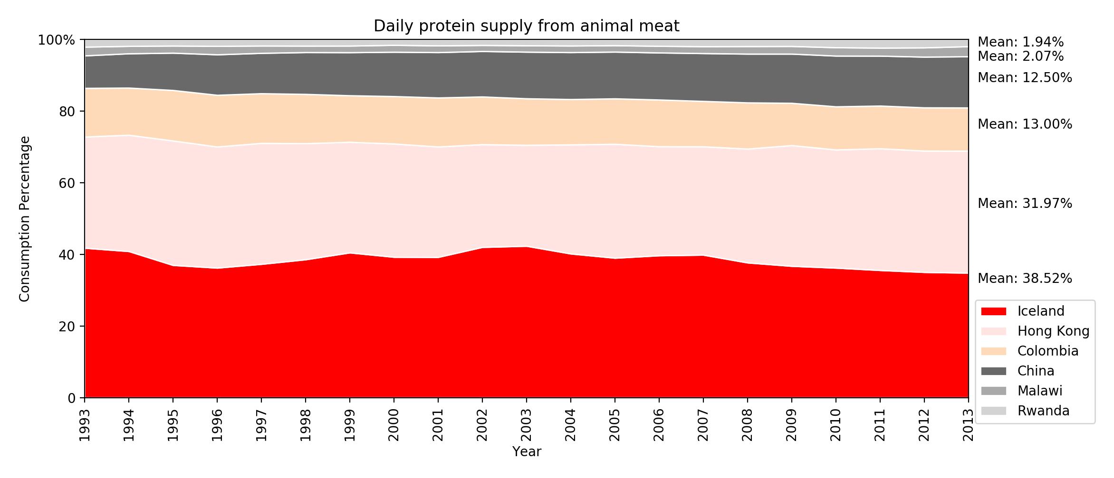
Daily Consumption Percentage
Notes:
If we were to split a cow between the top 2, middle 2, and bottom 2 countries. 75.5% goes to Iceland & Hong Kong. 25.5% goes to Colombia & China. 4% goes to Malawi & Rwanda

Slide 13
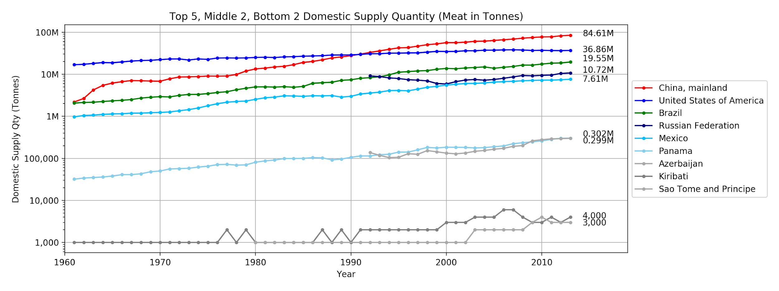
Which Countries Consume the Most Meat?
Notes:
Before 1990, USA lead the way on domestic supply qty. After 1990, China took the lead.

Slide 14
Meat Production
Which Countries produce the most meat?

Slide 15
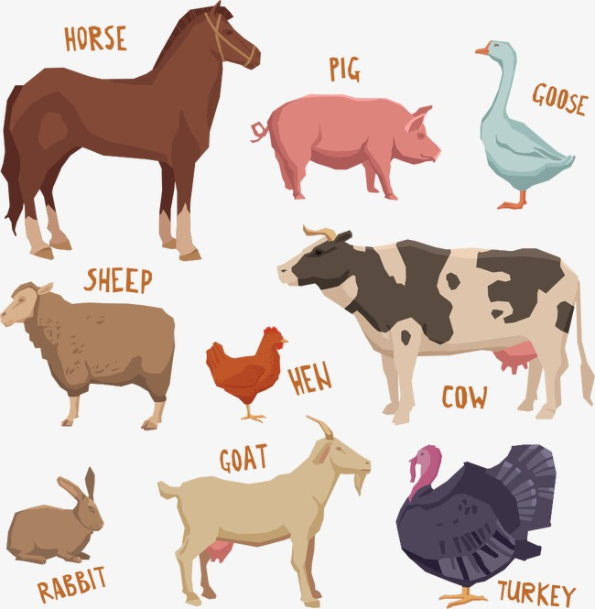
Livestock Production
Livestock stands for as farm animals who are raised to generate a profit

Slide 16
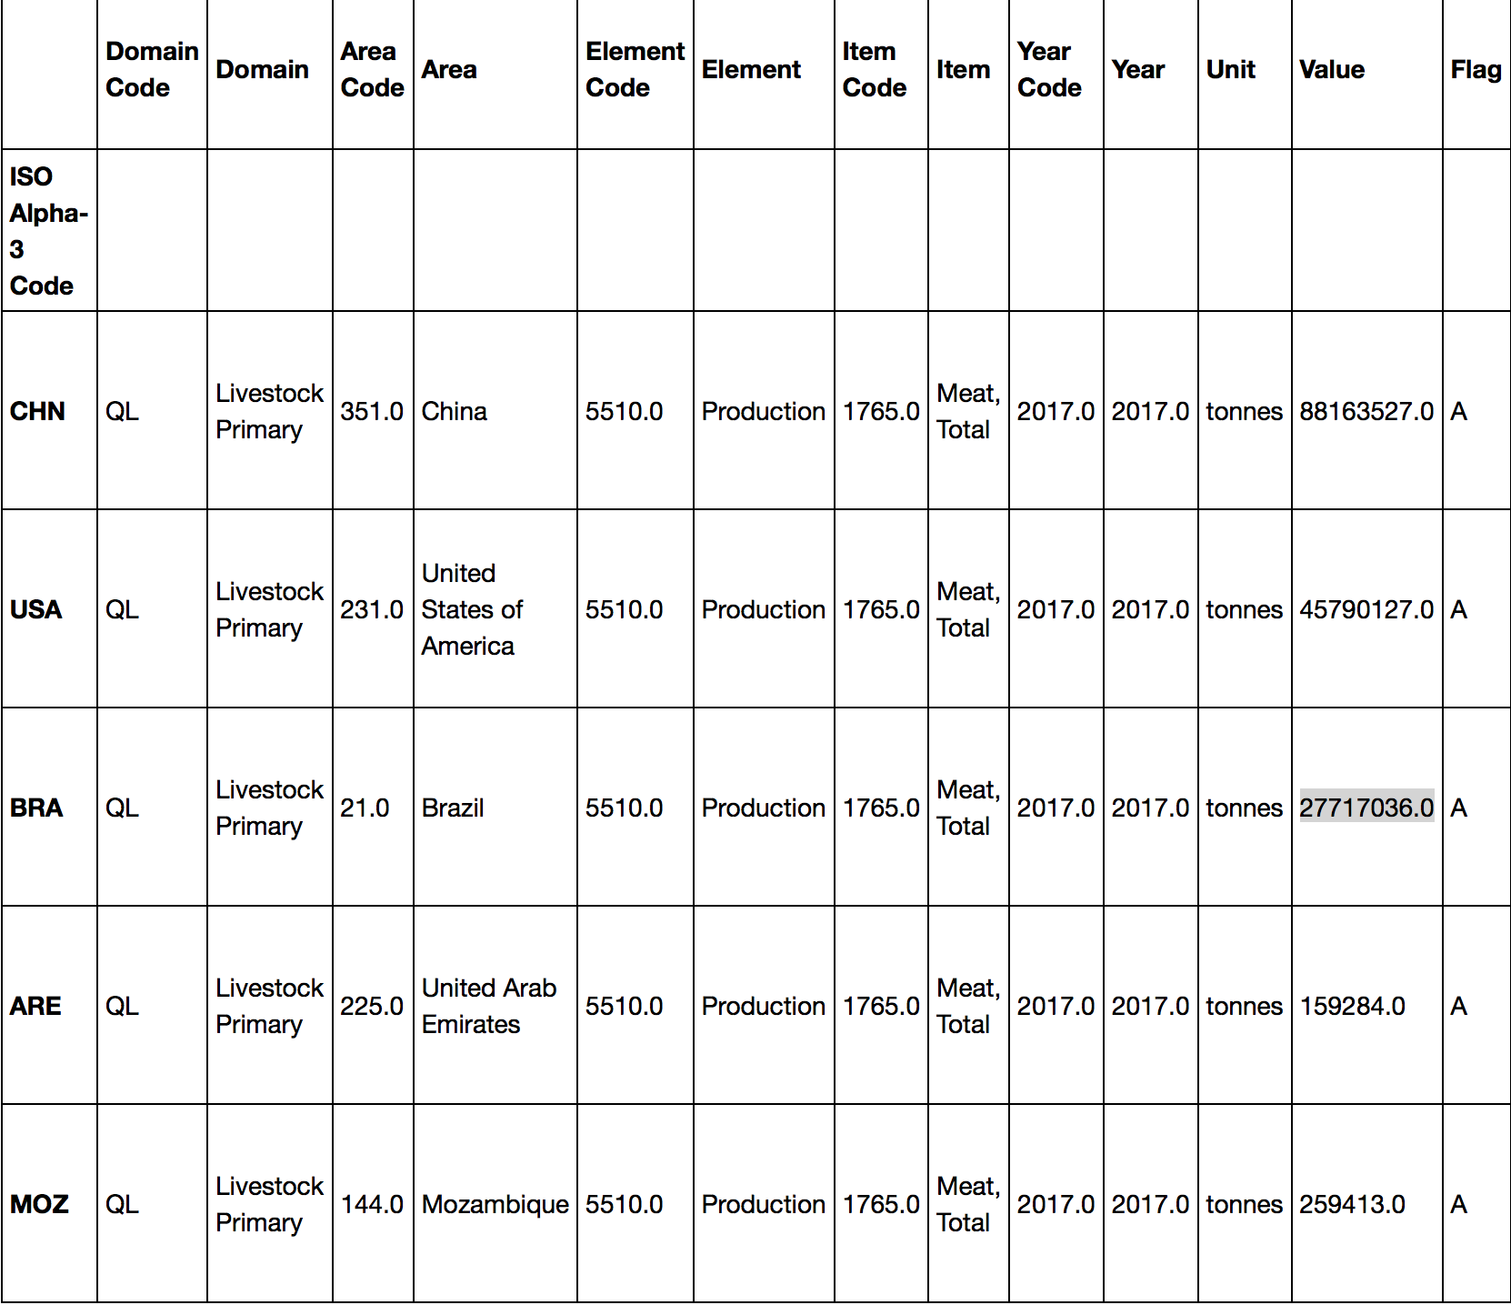
Which Countries Produces the Most Meat?

Slide 17
Dedicated Graze Land (%)
Graze Land Visualization
Notes:
Percentage of land each country dedicated to grazing

Slide 18
Total Meat Livestock Production
Total Meat Livestock Production
Notes:
USA lead the way in production before 1990. Post 1990 became China.

Slide 19
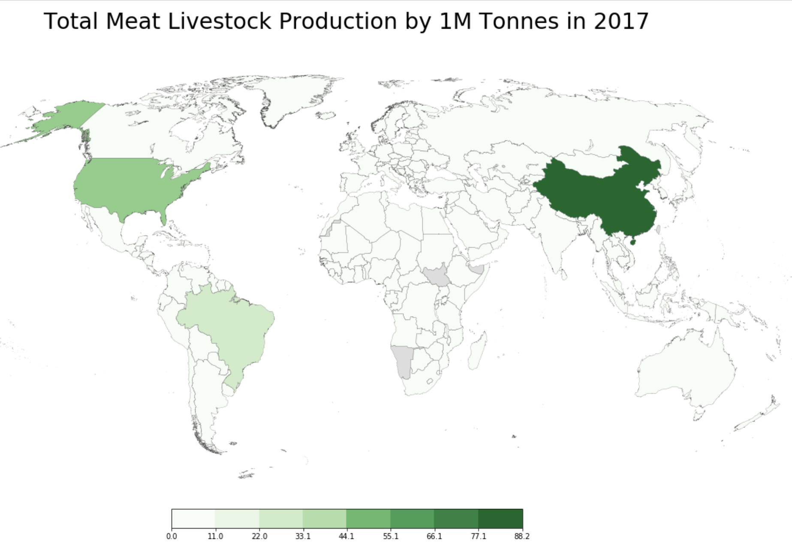
Notes:
-http://ramiro.org/notebook/basemap-choropleth/
From Ramiro Gomez

Slide 20
Import / Export of Meat

Slide 21
How much meat is imported and exported globally?
How do specific country groups compare to the world total?
Globalization is here to stay. With meat consumption at a high, it was interesting to see which country groups imported and exported meat the most. Initially, the analysis was to see where the US imported from and exported to, but essential US government data websites were unavailable. That said, the country groups selected included: United States, European Union, Low Food Deficient Countries and the BRICS countries.

Slide 22
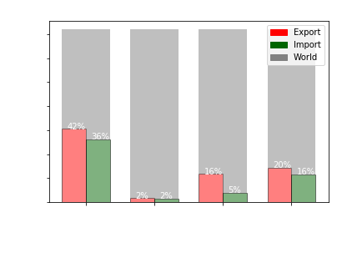
How much meat is imported and exported globally?
EU = European Union, comprising of 28 countries
LIFDC = Low Income Food Deficit Countries. This represents 54 countries, where 72% are located in Africa.
BRICS = Brazil, Russia, India, China and South Africa. These are the top 5 emerging national economies.

Slide 23
Food Supply Subsidization

Slide 24
Which Countries are subsidizing food supply the most?
Subsidies and budget is one of the biggest challenges that countries face when determining the ability to supply resources of what people demand. In our case, we decided to use the final goods/services produced by the country. We decided to show all countries and their subsidies by decade within the last 20 years and converted all currency to US dollars for consistency.
US leads in subsidized meat production, but this is due to incomplete data. Countries such as China (largest consumer) did not provide their subsidized data.

Slide 25
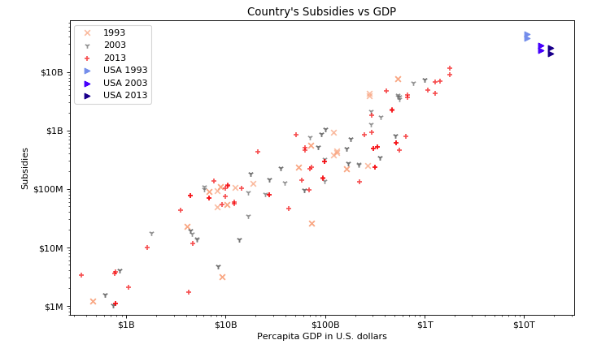
Government Expenditures: Subsidies
Notes:
Set up final url > Add GDP and merge based on country code and year based on US $ value > decades for fewer values
GDP appears to correlate with the subsidy each country support. Regardless of the year, each country allocates a consistent % of their GDP to subsidies for their meat cultivation.

Slide 26
In conclusion ...
The US is the 2nd largest meat consuming country after China.
There is a positive linear correlation between Per capita and budget; below the regression line means less per capita and countries above have a larger budget.
A country’s GDP seems to collate with it’s meat consumption.
World’s total import / export of meat is 700M + tonnes.
US exports a large % of meat than imports it into the country.
The US was the outlier in subsidized meat production, but this is due to incomplete data. Countries such as China (largest consumer) did not provide their subsidized data.

Slide 27
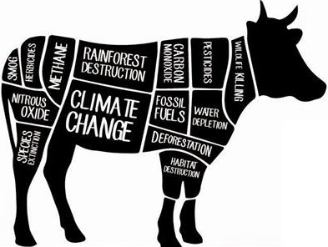
Questions?

Slide 28
APPENDIX

Slide 29
Resources Used
Country Demographics
https://data.worldbank.org/country
https://data.worldbank.org/country/china?view=chart
Meat consumption
http://www.fao.org/faostat/en/#country
https://data.oecd.org/agroutput/meat-consumption.htm
https://ourworldindata.org/meat-and-seafood-production-consumption
Country vs. Grazing Land over a course of 10 years (Global Footprint)
https://www.kaggle.com/footprintnetwork/people
http://data.footprintnetwork.org/#/countryTrends?type=BCtot,EFCtot&cn=2004
https://www.kaggle.com/footprintnetwork/national-footprint-accounts-2018
US Meat import / export sources
https://www.usmef.org/news-statistics/statistics/
http://www.beefusa.org/CMDocs/BeefUSA/Publications/CattleFaxSection.pdf
https://catalog.data.gov/dataset/livestock-meat-international-trade-data
US - Food Subsidy source
https://farm.ewg.org
Supplemental Data
Country vs. CO2 emissions over a course of 10 years (Global Footprint)
(http://www.fao.org/faostat/en/#country/84)

